Slide 1
FINAL INDIVIDUAL PROJECT
NAME: ARJUN PATEL
STUDENT ID : 0812257
SECTION : DAB 004
SUPERSTORE ANALYSIS

Slide 2
TABLE OF CONTENTS
01
02
INTRODUCTION
EDA
03
04
PRJOCT CLOSURE
INSIGHTS & RECOMMENDATIONS

Slide 3
01
INTRODUCTION
SUPERSTORE ANALYSIS

Slide 4
INTRODUCTION
Superstore management involves determining what products to sell, to whom, and where to offer them in order to maximize profits. Take a look at what, where, and who the regular consumers are, as well as what they frequently purchase. Moreover, we can forecast your potential future earnings using sophisticated mathematics (such as a training a model). Choosing wisely what to sell and where to sell it will help your store perform even better.

Slide 5
02
EDA
Exploratory data analysis

Slide 6
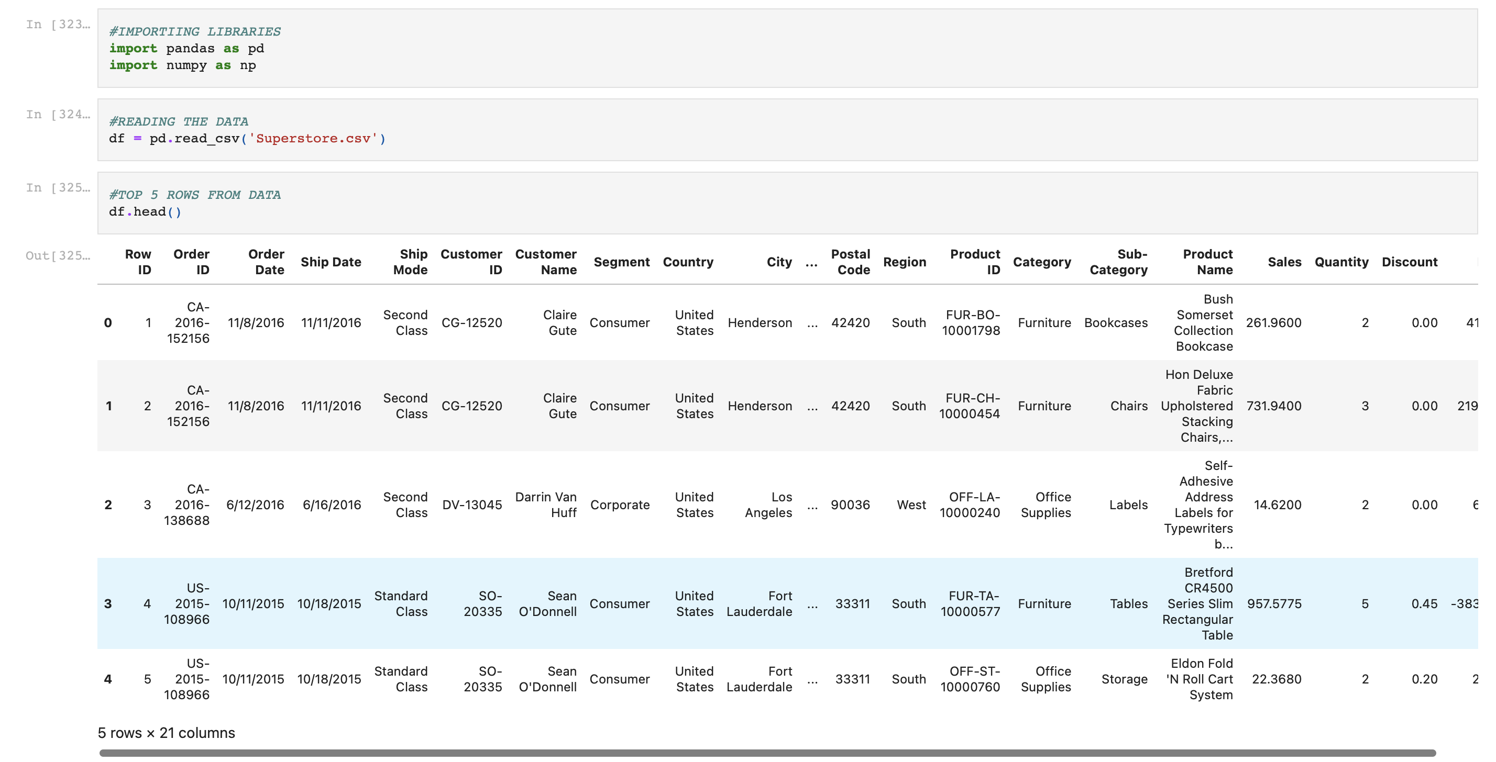
IMPORTING LIBRARIES & READING THE DATA

Slide 7
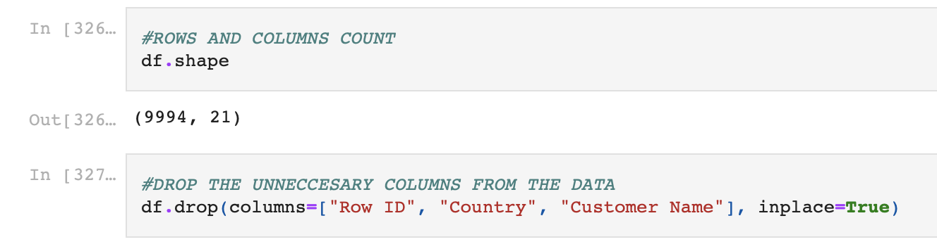
SHAPE COUNT & DROPPING COLUMNS

Slide 8
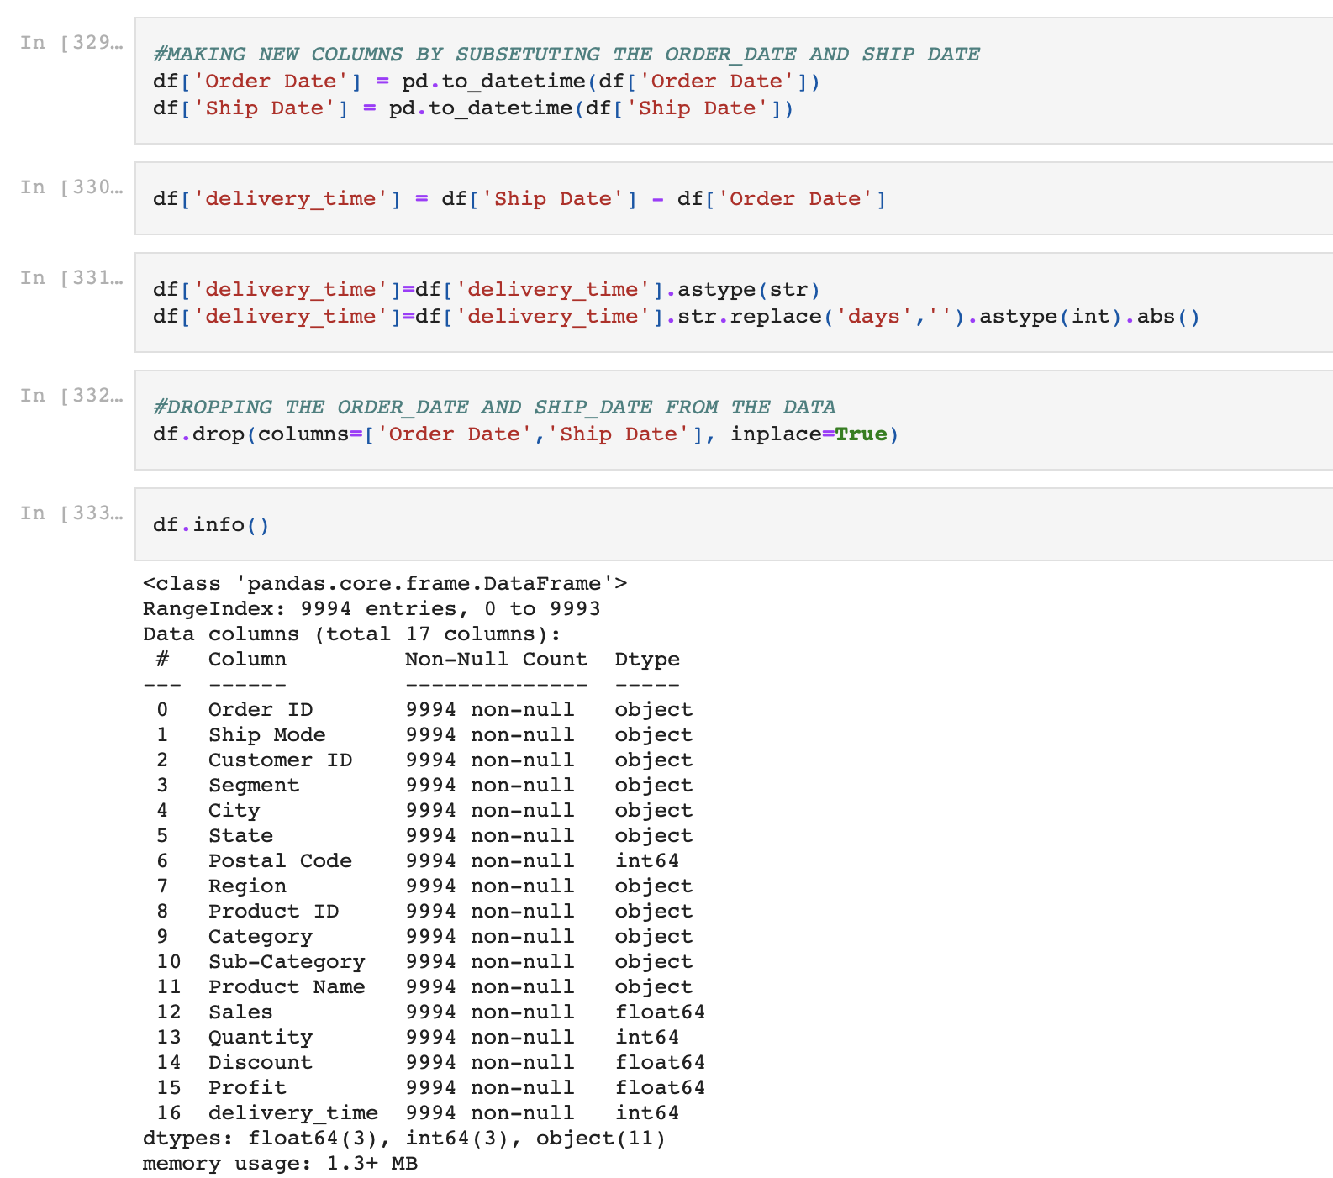
MAKING NEW COLUMNS & VERIFYING NULL VALUES

Slide 9
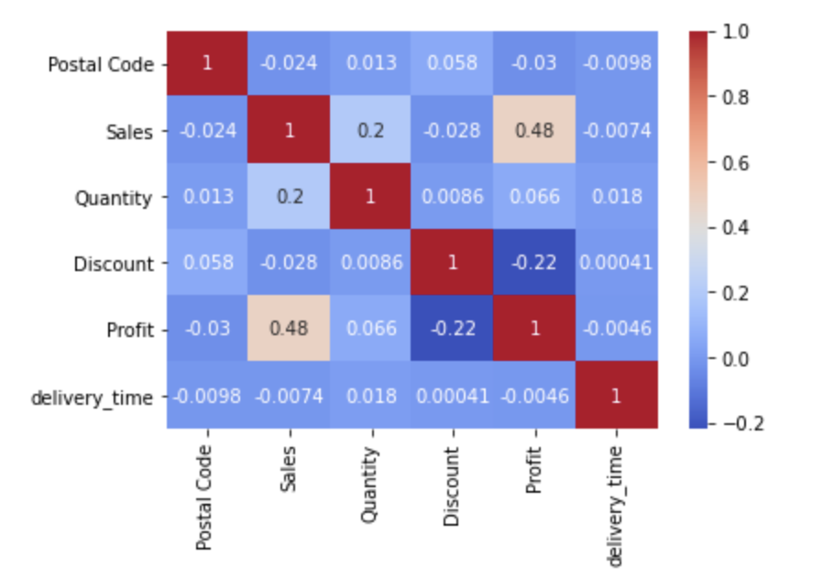
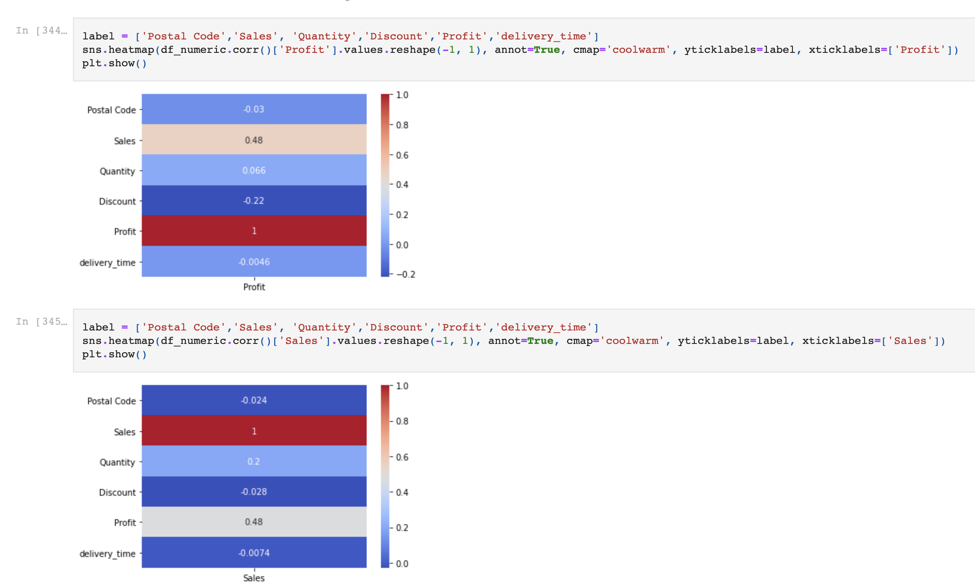
Correlation

Slide 10

03
INSIGHTS & RECOMMENDATIONS

Slide 11

INSIGHTS

Slide 12
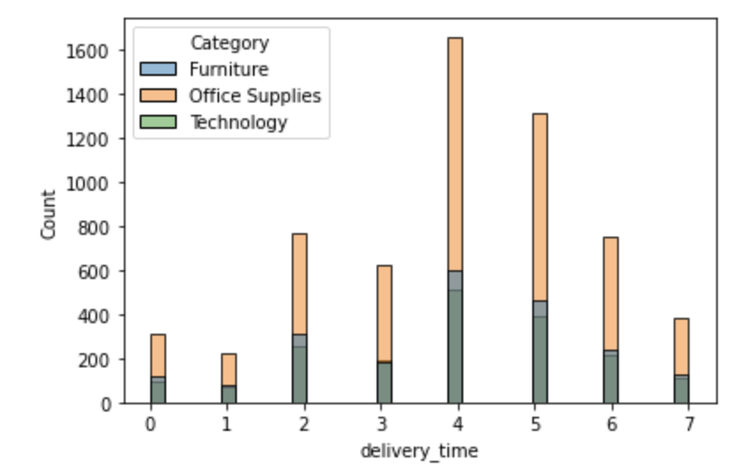
AVERAGE TIME TAKEN FOR DELIVERY?
Ans : 4
DELIVERY TIME COUNT FOR CATEGORY

Slide 13
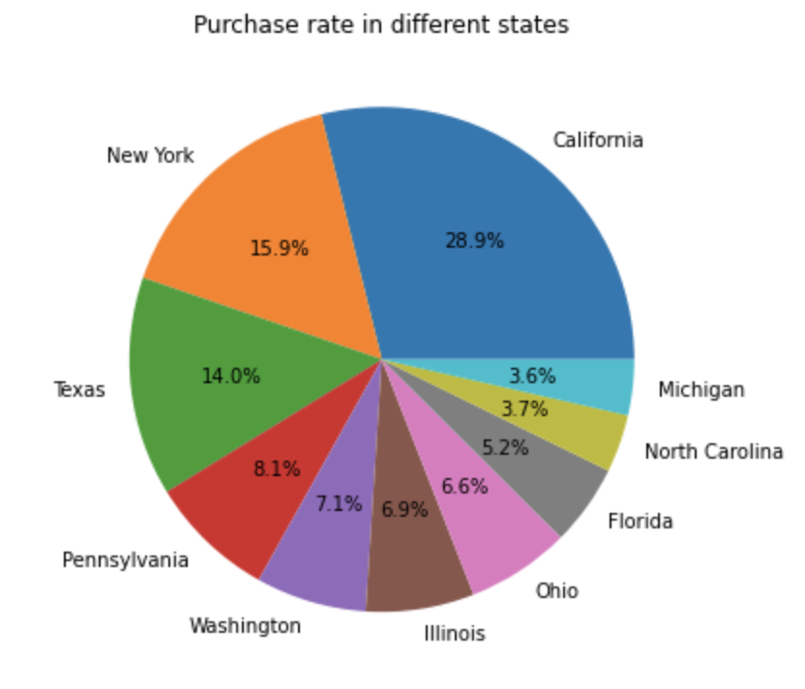
28.9%
15.9%
CALIFORNIA
HIGHEST PURCHASE RATE
NEW YORK
2ND HIGHEST PURCHASE RATE
3-6%
14%
MICHIGAN, NORTH CAROLINA & FLORIDA
TEXAS
3RD HIGHEST PURCHASE RATE
Least among all other
PURCHASE RATE IN DIFFERENT STATES

Slide 14
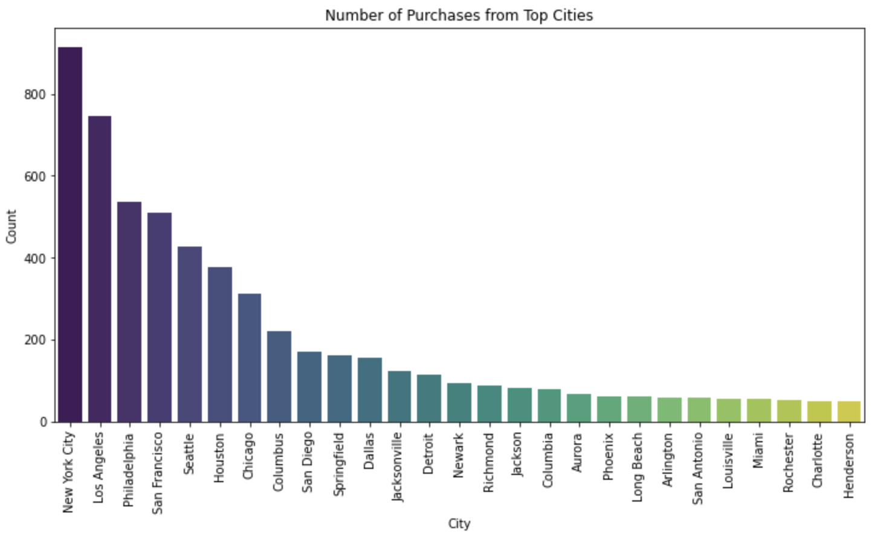
NUMBER OF PURCHASES FROM TOP CITIES
NEW YORK
MORE THEN 800 PURCHASE HAPPENED FROM NY CITY
LEAST PURCHASE COUNT
HENDERSON, CHARLOTTE, ROCHESTER, MIAMI…

Slide 15
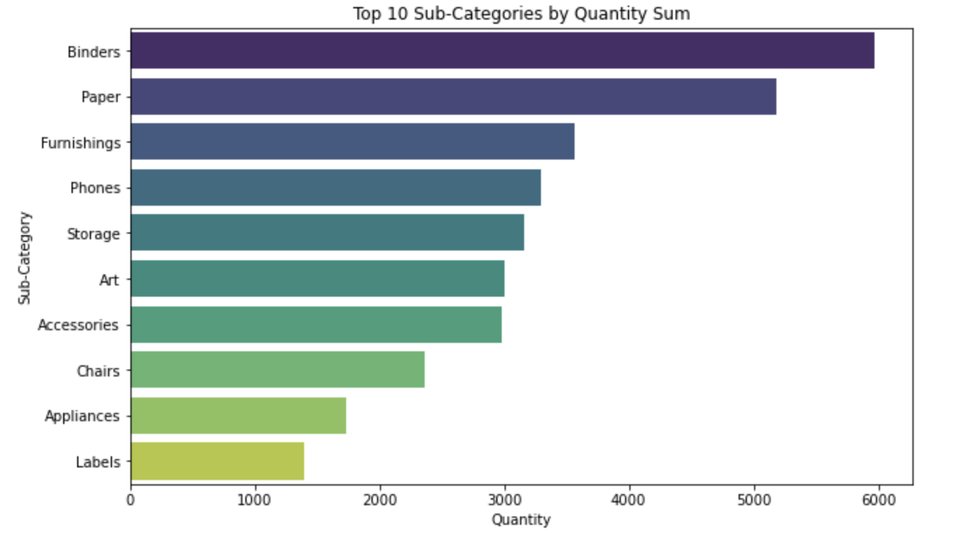
TOP 10 SUB CATEGORIES VS QUANTITY

Slide 16
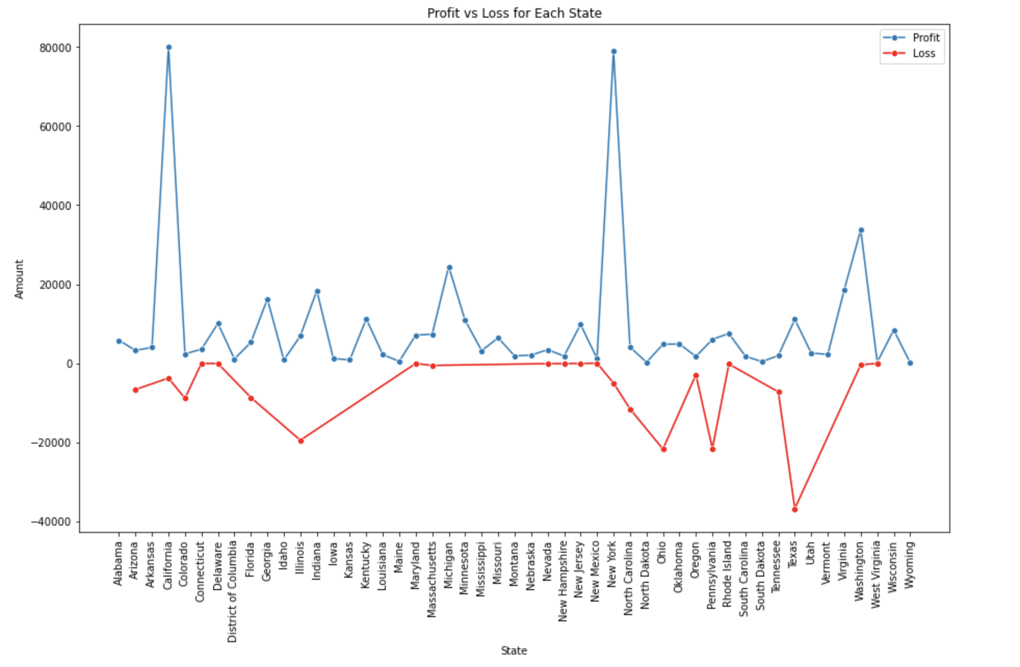
PROFIT
NEW YORK, CALIFORNIA
LOSS
TEXAS
PROFIT VS LOSS FOR EACH STATE

Slide 17
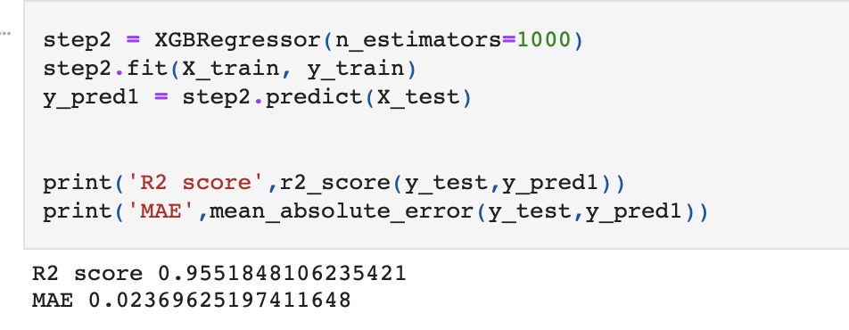
XGBOOST MODEL

Slide 18
RECOMMENDATION
After exploring the dataset, I have identified a potential problem related to product recommendations and customer satisfaction. While Superstore offers a wide range of products, customers may struggle to find products that align with their preferences and needs.
Additionally, understanding customer sentiments and preferences can be challenging without customer reviews and ratings.
Also to improve the sales, Market Basket Analysis is important to know about the customer behaviour.

Slide 19
PROJECT CLOSURE
04

Slide 20
PROJECT CLOSURE
In managing the Superstore, we focused on deciding what to sell, to whom, and where to boost profits. We analysed who our regular customers are, what they like, and where they shop. Using advanced math, we forecasted potential future earnings. From our findings, we discovered an issue with product recommendations and customer satisfaction. Customers may struggle to find what they want, especially without reviews, New York and Texas yield the highest profits.
To improve sales, understanding customer behaviour is crucial. In closing, our project suggests that optimizing product recommendations, encouraging customer reviews, and leveraging insights from Market Basket Analysis, especially in New York and Texas, can significantly enhance the Superstore's performance.

Slide 21
THANK YOU !!!
SUPERSTORE ANALYSIS

